Slide 1
Confidentiality Notice
This presentation and all the information contained herein is the confidential information of Microsoft and is disclosed to you pursuant to, and protected under, your company’s nondisclosure agreement with Microsoft. Do not reshare unless expressly authorized by Microsoft in writing. Further, this presentation is for discussion purposes only, subject to change, and should not be interpreted as a binding agreement or commitment on the part of Microsoft.

Slide 2
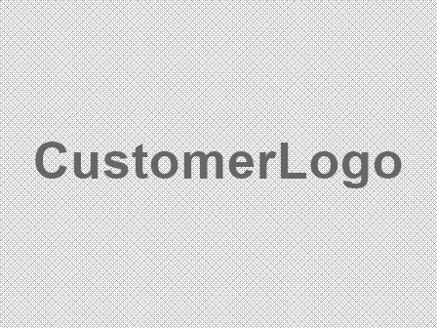
Driving success for dmg media with Microsoft Unified – Azure Bridge
04/07/2026

Slide 3
A partnership for your transformation journey
Now, more than ever, it’s not just the technologies that matter. It’s the partnership behind them.
The rapid pace of innovation gives us the ability to achieve things we never imagined. But new opportunities present new challenges.
Do you have the right level of ongoing, preventative care to maintain resiliency?
Can your IT environment withstand the increasing sophistication and volume of cyber attacks?
Do you have the right mix of people, process, and technology to harness the power of generative AI?
Notes:
Every organization in the world is on a journey of transformation, and the speed of innovation is only increasing.
What we’re seeing in the marketplace is that customers are looking for a technology vendor that can also be their transformation partner, that your support experience must be as innovative and comprehensive as the technology solutions themselves
These are just a few questions we’d like to ask to understand where you’re at in your transformation journey (Note: depending on the length of your meeting, consider pausing and discussing these questions w/ your customer or asking them rhetorically, as though these are common questions every organization is grappling with)
Do you have a resiliency plan in place to keep your solutions healthy and operational?
Do you feel confident about your ability to withstand the growing number of cyber threats and bad actors?
What is your AI strategy – not just for implementing the technology, but making sure you get everything right – from people to processes to technology?

Slide 4


Your journey—with the full power of Microsoft beside you
Empower Cloud Success
Connect directly with Microsoft architects to unleash the full potential of your technology investment — at every step of your journey
Achieve business success with direct and continuous access to our unmatched expertise, empowering you to strengthen resiliency, drive innovation, and maximize your Microsoft technologies.
Microsoft
Unified
Strengthen Security and Resiliency
Increase the security and continuity of your environment while minimizing downtime through prescriptive technical engagements
Drive AI Innovation
Maximize your advantage by co-creating transformative solutions with Microsoft to unleash the power of AI and emerging technologies
Notes:
You know your business. We know our technology. We partner with you to provide direct and continuous access to unmatched expertise, with strategies designed to accelerate your success.
It starts with Empowering your Cloud Success. The Unified experience allows you to connect directly with our Cloud Solution Architects, who are experts on the products you rely on. It’s their job to make sure you are using our technologies to their full potential. With tailored and regular success planning, expert-led workshops, and enhanced reactive support experiences, Unified is the cornerstone for your success with Microsoft.
Next, Unified helps to Strengthen your Security and resiliency to build a durable, safe, and high-performing organization. We help you increase the security and continuity of your technologies while minimizing downtime through deep technical engagements, proactive incident preparedness, and elevated support for your mission critical solutions.
Finally, Unified helps you Drive AI innovation. Organizations everywhere are grappling with how to seize the full potential of AI, while safeguarding their business, their data, and their employees. With direct access to Microsoft experts, Unified allows you to kick start and maximize your AI and Copilot adoption to generate real business value and stay ahead of new technologies
Now let’s dive into each of these to show you how Unified helps you maximize your investments with Microsoft.

Slide 5
A connected, flexible experience
Tailor your Microsoft Unified journey through services that drive the outcomes you need most
Maximize
Full care for your most critical solutions
Your strategic partner
Transform
Proactive, expert-led engagements to accelerate adoption of cloud solutions
Direct connection to Microsoft through Success Management Services, orchestrated by a Customer Success Account Manager
Enable
Guidance to avoid common support issues and decrease the likelihood of outages
Engage
As-needed support for all your Microsoft products and services with escalation management
→
Interact
On-demand IT health assessments, technical trainings, and case management
Specialized services tailored to your outcomes
No matter how simple or complex your needs, we have the services, experience, and skills to ensure your success
Foundational services included in your agreement
Notes:
The Microsoft Unified experience is not one-size-fits all. It’s a connected experience that can be tailored to fit the unique needs of our customers.
Unified offers foundational services, such as on-demand digital training and assessments, as-needed reactive support with escalation management, and advisory support for customers looking to brainstorm possible solutions to problems. These services are included with every Unified agreement and for every member of the organization
On top of the foundational services, we have two types of specialized services. The first is Value Acceleration, which are led by Cloud Solution Architects and designed to help with solution adoption. These services are built from a foundation of Microsoft Intellectual Property, proven methodologies, and unmatched product expertise. And new IP gets developed all the time as products change and as new products become available
The second type of specialized service is Mission Critical, which provides preventative, prescriptive care for your most critical solutions.
And your entire experience with Unified involves a strategic partnership, with Success Management Services providing you a direct connection into Microsoft.

Slide 6


Coverage to match your needs
Get started with Unified Enterprise coverage for selected cloud(s), available for a limited time
Meet your foundational needs
A transitional bridge to full Unified Enterprise
Tailor your cloud-only solution for success
Empower Cloud Success
Upfront planning to ensure alignment between your business priorities and our technical execution
Choose the Microsoft cloud(s) you want supported:
Azure | Microsoft 365 | Dynamics 365/Power Platform | Security | Copilot
Benefit from a tailored Unified Enterprise agreement with an annual contract priced as a percentage of your selected cloud(s) spend only
Receive an allowance based on contract list price to apply towards the cost of Enhanced Solutions.
At your next renewal, transition to full Unified Enterprise with coverage for your entire Microsoft portfolio, including other clouds and your on-premise environment
→
Strengthen Security and Resiliency
Rigorous strategy for the security, optimization, and resiliency of your Microsoft investments
→
Drive AI Innovation
As-needed advisory services and an online hub of on-demand AI learning content
→
Notes:
Pricing based on license spend for selected cloud(s), Software Assurance Benefits are not applicable
Reactive support available only for selected cloud(s)
Most Enhanced Solutions available (ARR available only with Azure Cloud)
Access to all on-demand learning content

Slide 7
Graduated pricing rates for Azure
The cost of your Unified Bridge agreement is based on a percentage of your historical annual product spend, using graduated pricing rates.
Graduated pricing rates
How is pricing calculated?
Unified price is dependent on the Microsoft Licensing spend by product class, called Product Spend (P).
For the Unified Bridge for Azure, we calculate your ‘P’ using your previous 12–months of Azure consumption, after discounts and before credits are applied
Rates are graduated, so if you have $6M in annual Azure spend, it would be calculated as 10% of the first $1.8M and 7% of the next $4.2M ($1.8M-$6M)
To maximize your Azure adoption, Microsoft recommends investing an additional 1-4% in Enhanced Solutions
Annual spend | Rate by tier
$0 to $1.8M | 10%
$1.8M to $6M | 7%
$6M to $12M | 5%
$12M to $30M | 3%
$30M to $60M | 2.25%
$60M to $120M | 2%
>$120M | 1.75%
Floor Price | $50K
What products and services are covered?
The Online Services for which technical support will be available can be found at aka.ms/UnifiedBridge-Azure
Notes:
Speaker Notes
One area we have been focusing on is how we can make Unified pricing less complex and more aligned to how you purchase and use Microsoft products
To that end, effective February 1, 2023, we implemented several pricing changes that will benefit your organization:
Simplify how pricing is calculated: This will help you see a clearer connection between your Microsoft technology purchases last year last year and your Unified price.
Unite pricing tiers across products: Get pricing aligned with your changing business needs, with pricing tiers united across similar product type.
Improve value for our customers: User rates, including Modern Workplace and all our Microsoft 365 products, have been reduced by 0.5% for all tiers, which ensures we’re a price performance leader across multiple products for support

Slide 8
Specialized services tailored to your outcomes
Apply the flexible portion of your agreement or purchase these services as add-ons
Value Acceleration Services
Expert-led engagements for your cloud journey
Mission Critical Services
Full care for your most critical solutions
Designated Engineering
Pre-packaged services that focus on a single workload delivered with expert advisory over the course of a few months
Events
Preventative guidance and heightened incident response before, during, and following a critical event
Products
Microsoft-led engagement driven by a designated technical advocate for the solutions your business relies on most
Enhanced Designed Engineering
Flexible, long-term engagements for your cloud solution success, delivered by designated, deep technical advisors
Workloads
Our most advanced service focused on your business-critical solutions delivered by a designated team of experts
Notes:
These specialized services can be purchased using a flexible portion of your agreement or as add-on services.
Value Acceleration Services are built upon the robust foundation of Microsoft Intellectual Property, coupled with our deep product expertise and proven methodologies
Unified customers have the flexibility to choose the engagement model that best aligns with their needs.
Whether you are seeking immediate results or a more comprehensive, long-term strategic collaboration, our Microsoft-led engagements are designed to accelerate outcomes across your key solutions, ensuring you get the most from your technology investment.
Mission Critical Services help customers embark on their journey with confidence, knowing our unmatched expertise is by their side.
Your assigned technical team, equipped with advanced capabilities, delivers a holistic approach—proactive, preventative, and reactive—to meet your business and technical needs, ensuring your priorities are achieved with precision and success.
There are services available around critical events, services for single products, or advanced services for your business-critical workloads

Slide 9
Why Microsoft Unified for dmg media
A modern approach to customer success that that meets the needs of your evolving organization and helps achieve business outcomes
Our relationship – A continuously evolving collaboration
Your priorities | Description | How Unified can help
Proactive Services and Risk Prevention | pre-migration risk assessments, design validations, and best-practice guidance | Unified allows dmg media to conduct pre-migration risk assessments, design validations, and best-practice guidance that reduce the likelihood of disruptions. Customers have access to "on-demand assessments that drive awareness of security and help manage and improve platform health across the Microsoft technology stack“ and Customer Success Programs.
Engineering Engagement and Expertise Access | direct access to Microsoft product engineers, Cloud Solution Architects, and Product Group advisors through Mission Critical Services | For Azure-related critical incidents, Unified provides a 15-minute first-call response with continuous 24×7 effort and a critical situation resource assigned immediately. Unified includes rapid escalation within Microsoft to product teams and notification of Microsoft senior executives as required for Severity 1 incidents under Mission Critical Services. This direct pipeline into product engineering is confirmed as exclusive to Unified Support. Routing all Azure support incidents to a designated team of engineers with cloud service expertise who retain primary responsibility 24×7×365.
Support Escalation and Incident Response
Training and Upskilling Programs | On-demand learning and ESI | personalized engagement with dedicated Microsoft experts as an integrated part of your team, maximizing solution effectiveness by identifying issues and enhancing operational performance". implementing solutions while simultaneously upskilling your team — a "train-the-trainer" approach where "engineers embedded within your team support your objectives and upskill your team". Reducing in training expenditures after leveraging Unified's learning resources.
Ongoing Optimisation and Continuous Improvement | Post-migration assessments and optimization through Enhanced Designated Engineering | Assess to technology roadmaps and adoption guidance, ongoing review and recommendation through planned assessments and tailored engagement

Slide 10


Accelerate innovation with a comprehensive, AI-assisted migration and modernization approach
EDE Azure Platform
Maximize business agility
Respond rapidly to changing market needs and bring new business opportunities to market faster. Streamline and automate operations across the Azure platform to boost productivity and optimize cost and performance.
Unifying your data to unlock AI
Lay the foundation for AI by merging and modernizing your data estate,
enabling advanced analytics and intelligent applications. Ensure your
data is secure, scalable, and AI-ready across the Azure platform.
Secure your workloads with cloud native security
Partner with our experts to apply security across the full stack by unifying threat remediations. Minimize risks and proactively protect your workloads, data, and applications from emerging threads and vulnerabilities.
This presentation and all of the information contained herein is the Confidential Information of Microsoft and is disclosed to you pursuant to, and protected under, your company’s nondisclosure agreement with Microsoft. Do not reshare unless expressly authorized by Microsoft in writing. Further, this presentation is for discussion purposes only, subject to change, and should not be interpreted as a binding agreement or commitment on the part of Microsoft.

Slide 11
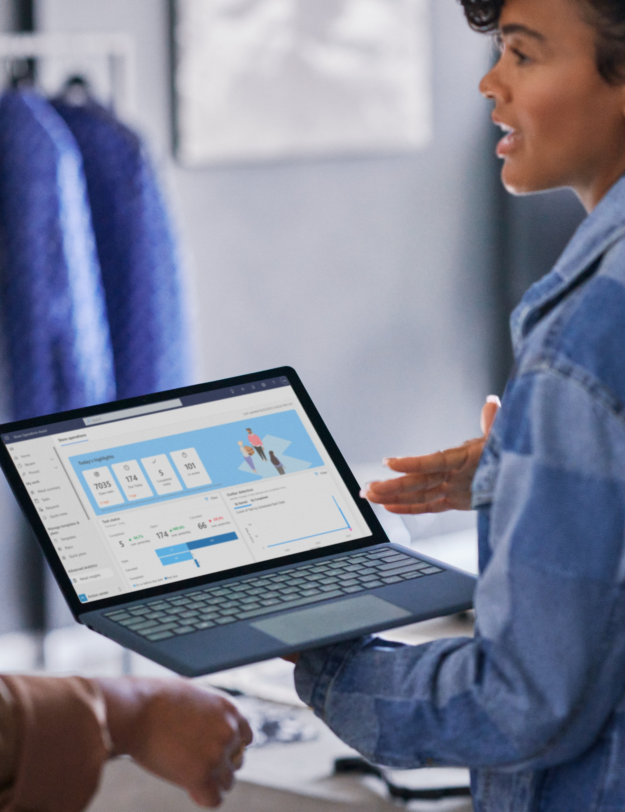
Mission Critical Services for Azure Platform
Coverage across your entire Azure footprint
Thorough assessments of your platform usage, and how to improve return on investment
Microsoft engineering recommendations to remediate risks and implement enhancements to strengthen the platform reliability
Expedited mitigation plan that considers your critical use of the Azure platform and business impact when a critical incident occurs
15 minutes or less initial technical response and 24/7 incident leads and business knowledge on all critical incidents
Proactive platform monitoring that allows you to respond quicker to issues before they become problems*
Tailored updates on the steps for mitigation and impact to your business during Azure outages*
*Mission Critical Services for Azure Platform Plus

Slide 12
Streamline your Microsoft investment with Microsoft Unified Multi-Year
With Unified Multi-Year, you simplify your purchasing experience with a licensing agreement that extends up to three years while enjoying the following benefits:
Longer-term predictability in budget planning by locking in rates for the duration of the contract
Aligned dates and length for your support agreement and Microsoft licensing agreements
Reduced administrative overhead with a streamlined budgeting and purchase process
Fixed pricing for the duration of the support period, unless new purchases exceed 10% of license spend

Slide 13
Streamline your Microsoft investment with Microsoft Unified for MACC
Meeting your desired outcomes through mutual investment in Unified Services to ensure the right level of services at the right time.
Protect your investment
Longer-term predictability in budget planning by locking in rates for the duration of the contract
Reduced administrative overhead with a streamlined budgeting and purchase process
Rate locking over multiple years to protect you against inflation of prices
Maximize ROI by committing to long-term Unified initiatives
Get the best available services
Unified agreement scope alignment with Microsoft licensing agreement
Outcome-focused services delivered at the right time based on your priorities and readiness
Highest tier of services for Azure availble with direct access to Azure Engineers and the product group with insights and input into Azure roadmap
Improved delivery experience with extended multi-year engagements that allow delivery team to build deeper knowledge of your environment
Success management services orchestrated by a Customer Success Account Manager (CSAM)

Slide 14
Benefit from a model that adapts to your needs
Personalize your experience through a mix of foundational and specialized services
Foundational services | Success Management Services | Provided digitally and/or by Customer Success Account Managers
Foundational services | Advisory | As-needed Advisory Phone Support (limited to six hours or less per incident)
Foundational services | IT Health | As-needed on-demand assessments with setup and configuration services
Foundational services | Technical Training | On-demand videos, hands-on labs, learning paths, and expert-led webcasts
Foundational services | Technical Support (as-needed) | Expected initial response times: Critical Sev 1: 15-minutes for Azure¹/1-hour for all other products (24x7) Sev A: 1 hr. (24x7) / Sev B: 2 hrs. (24x7 available upon request²) / Sev C: 4 hrs. (business hours only³)
Foundational services | Escalation Management | For Critical Business System Down issues, resource assigned after 15-minutes for Azure or 1-hour for all other products For Critical Business System Degraded, resource assigned after 1-hour for all products
Foundational services | Case Management/Tooling | Services Hub portal for one-stop support management, recommendations, Microsoft Services catalog, and product updates
Foundational services | Cloud Assistance | Billing support provided by the Azure Support team (included in the free support)
Foundational services | Third-Party | Select third-party support with interoperability and configuration guidance and troubleshooting
Specialized services | Value Acceleration Services | Expert-led engagements uniquely designed from Microsoft Intellectual Property to accelerate your cloud solution success
Specialized services | Mission Critical Services | Assigned technical team, equipped with advanced capabilities for your high priority events, products, and workloads
Foundational services
Specialized services
Read the full services description at https://aka.ms/UnifiedServicesDescription
¹ Does not apply to cases for Azure StorSimple, GitHub AE, Azure Communication Services or Billing & Subscription Management.
² If you choose 24x7 when you submit the support request, you commit to a continuous, 24x7 operation, every day with the Microsoft team until resolution. Otherwise, Microsoft may at its discretion provide service during business hours only.
³ Business hours are generally defined as 09:00 to 17:30 Local Standard Time, excluding holidays and weekends. Business hours may differ slightly in your country.
Notes:
Here’s a list of features included with Microsoft Unified Enterprise. You can see the full services description at aka.ms/UnifiedServicesDescription.

Slide 15
Summary of your Unified investment
 | Your tailored Unified experience |  | YR1 | YR2 | YR3
Technical Support | •Critical Sev 1: 15-minutes for Azure*/1-hour for all other products | As-needed | £200,599.57 | £155,819.00 | £208,295.00
(Organization-wide 24/7 problem resolution support) | •1-hour Sev A/2-hour Sev B/4-hour Sev C
Escalation Management | •For Critical business impact issues, resource assigned | Included
IT Health | •On-demand assessments and setup and configuration service | As-needed
Case Management/Tooling | •Services Hub portal for support management and recommendations | As-needed
Account Management | •Success Management Services orchestrated by a Customer Success Account Manager | Included
Advisory Support | •As-needed Advisory Phone Support | Included
Technical Training | •Access to on-demand videos and learning paths | Included
Flex Allowance |  |  | -£40,119.91 | -£37,118.00 | -£41,659.00
Proactive Services and Enhanced Solutions | Enhanced Designated Engineering | Azure Platform - 200 HRS | Funded by Flex Allowance | £73,500.80 | £75,706.40 | £77,977.60
MS Discount |  |  | -£81,219.26 | -£28,011.37 | -£23,393.28
TOTAL COST |  |  | £152,761.20 | £166,396.03 | £221,220.32
Optional Enhanced Offering
Mission Critical | Mission Critical Azure Platform |  | £259,827.00 | £260,539.00 | £259,827.00
For Discussion Purposes Only

Slide 16
The value realized by our customers
225% ROI over three years¹
2025 Forrester study shows how customers benefit from a proactive approach and strategic partnership with Microsoft
35%
60%
20%
The ability to access training resources helped us easily deploy Copilot across various parts of the organization… Unified helped us identify quick wins and use cases that could be deployed faster, allowing us to be more responsive to business stakeholders’ needs.”
– Chief Legal and Compliance Officer Manufacturing company
Reduction in IT support ticket volume¹
Reduction in implementation time for new Microsoft solutions¹
Reduction in time to execute cloud workload migration¹
¹The Total Economic ImpactTM of Microsoft Unified, March 2025: A commissioned study conducted by Forrester Consulting​
Notes:
Customers that use their Unified agreement as a success contract, instead of a reactive support contract, see tremendous value and returns on their investment.
Forrester calculated a 3-year ROI of 225%, and a large percentage of respondents saying Unified reduced ticket volume, help them migrate faster, and accelerate implementation of new technologies.

Slide 17
Pricing Assumptions
CONFIDENTIAL – FOR DISCUSSION ONLY
Pricing Valid to 30th June 2026
Assume Service for Azure Cloud only, aligned to MACC assumptions
Subject to Service Scoping and planning to align to dmg media priorities
Unified Standard Terms & conditions are non negotiable
30-day payment terms
This proposal includes information that should not be disclosed to any parties and should not be duplicated, used, or disclosed for any purpose other than internal evaluation.
This proposal is subject to the terms of your Microsoft Business and Service Agreement
Microsoft’s proposal is predicated solely and exclusively upon the agreements and information contained in Microsoft’s proposal response, and no other terms and conditions shall apply.

